Slide 1

Chapter 1: Communication: Essential Human Behavior

Slide 2


The Functional Perspective
How we use communication in relationships
Expressing affiliation
Managing relationships
Influencing others

Slide 3

Six Characteristics of Communication
Communication is symbolic.
Both language and behavior are symbols.
Communication requires a shared code.
People construct messages (encode) and interpret messages (decode).
Communication is linked to culture.
Culture includes shared beliefs, practices, values, and language.
Communication need not be intentional.
Spontaneous, unintentional communication occurs through emotions or body movements.
Communication occurs through various channels.
Channels include face-to-face, e-mail, text messages, books, and so on.
Communication is a transactional process.
It requires two or more people acting in both sender and receiver roles.

Slide 4

What is considered Competent Communication?
Outcome
Process
Optimizes outcomes for both partners, with mutual satisfaction the goal
Ethics
Values ethical standards of right and wrong
Our personal values -- the way we were taught (what to believe), ultimately affects how we analyze situations and messages that are coming towards us

Slide 5
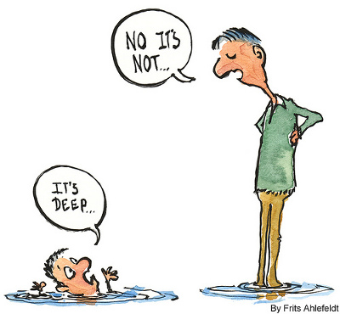
Competent Communication (cont)
Appropriate and effective
Adapts to the situation (behavioral flexibility)‏
Watch what you say...how and when you say it can affect your message unintentionally
Helps achieve goals based on the situational context

Slide 6


Slide 7


Competent Communication (cont)
Tied to well-developed communication skills
Requires understanding of social norms and behaviors
Related to using technology
Requires using the right channel appropriately

Slide 8
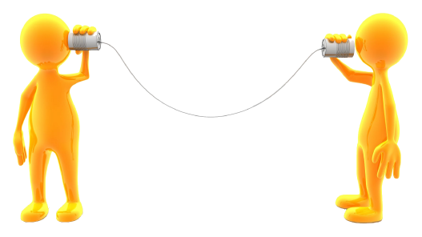
Communication Models

Slide 9
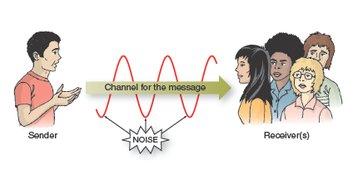
Linear Model

Slide 10
Linear Model
This model depicts communication in only ONE direction
Sender originates communication with words/actions formulating the message to the receiver
In between the CHANNEL, there is noise (i.e., distractions, interruptions)
Examples of Linear Models:
Television
Radio
Electronic signals
The Linear Model is not as useful...why?

Slide 11
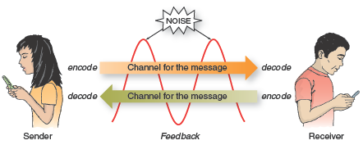
Interaction Model

Slide 12
Interaction Model
This model is a TWO-directional process
Incorporates feedback into communication between sender and receiver
Noise may occur along the way
Feedback
A message from receiver to the sender that illustrates how the receiver is responding
Can be verbal message but also nonverbal (i.e., nodding, smiling, frowning)
Instant messaging
The amount of time you take responding to a text affects the other individual’s interpretation of the message

Slide 13
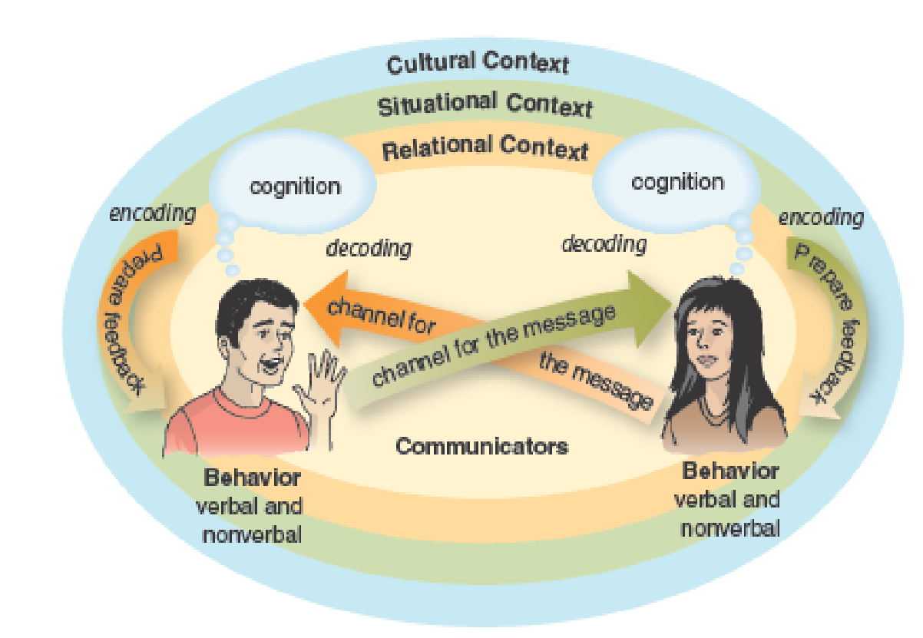
The Competent Communication Model

Slide 14
The Competent Communication Model
This model is considered to be effective and appropriate
Includes feedback
It shows communication is ongoing
Transactional process are interdependent → their actions affect one another
This transaction changes depending on the situation and type of communication that is being used
There are 4 main spheres of influence at play in Competent communication models
Communicators
Relationships
Situation
Cultural setting

Slide 15

Communicators
Communicators are influenced by cognitions
The thoughts they have about themselves and others; their understanding/awareness of who they are
This ultimately affects how you behave
Behavior
Observable communication (verbal and nonverbal)
Your cognitions are encoded into the messages you send, which are then decoded by your communication partner into their own cognitions that influences their feedback to you
Cognitive Complexity
These communicators imagine multiple scenarios, formulate multiple theories, and make multiple interpretations when encoding/decoding

Slide 16

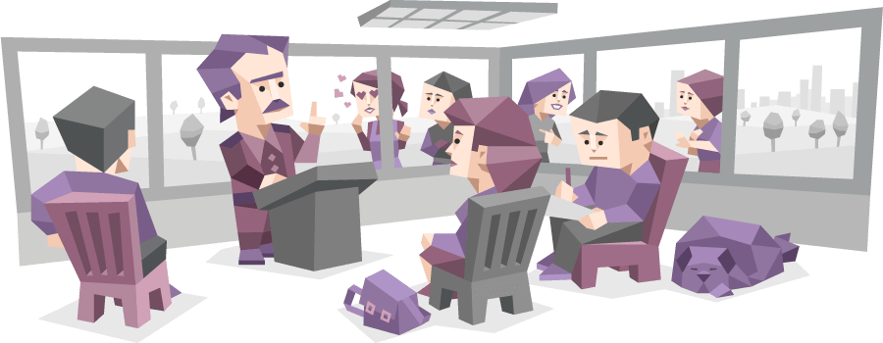
Relationships
All communication occur within the context of a relationship
You adjust the way you communicate depending on the relationship between you and the other individual (i.e., friend vs. parents, best friend vs. acquaintance, co-worker vs. friends)

Slide 17
Situation
Situational context refers to
Where you live
Where you work
Your home
The time of the day/night
Current events in the particular environment of the time
The circumstance surrounding communication influences communication

Slide 18


Slide 19

Cultural Context
Culture plays a significant role in how we communicate
How we were raised to believe
Cultural identity
How individuals view themselves as members of a specific culture influences the communication choices people make and how they interpret the message they receive from others

Slide 20
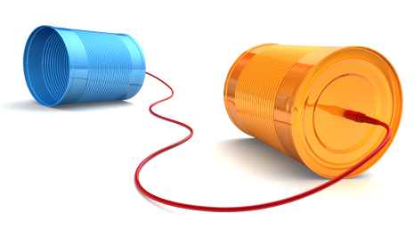
The Study of Communication
Basic communication processes
Interpersonal communication
Group and organizational communication
Public speaking
Mass communication

